Slide 1
Some notes
Lars Vilhuber
Cornell & AEA Data Editor

Slide 2
Perspectives from the academic publication process
Opportunities
Challenges
Boring stuff

Slide 3
Grounding the approach

Slide 4
Data
Research finding
Software

Slide 5
Data
Analysis data
Analysis code
Software

Slide 6
Data
Good replication package
Analysis data
Analysis code
Software

Slide 7
Data
Good replication package
Analysis data
Analysis code
Software

Slide 8
Data
Secondary data
Analysis data
Analysis code
Data cleaning code
Software

Slide 9
Data
Better replication package
Secondary data
Analysis data
Analysis code
Data cleaning code
Software

Slide 10
Data
Ipums
Author-created survey
Data provider
Author-obtained firm data
Census Bureau
Secondary data
Analysis data
Software provider
Analysis code
Data cleaning code
Software

Slide 11
Data
Data provider
Secondary data
Stata
Analysis data
Software provider
SPSS
Analysis code
Data cleaning code
Software

Slide 12
Data
Data provider
Secondary data
Analysis data
Software provider
Analysis code
Data cleaning code
Software

Slide 13
Data
Data provider
Secondary data
Analysis data
Software provider
Analysis code
Data cleaning code
User code packages
Software

Slide 14
Data
Data provider
Secondary data
Analysis data
Software provider
Analysis code
Data cleaning code
User code packages
“Software”
Software

Slide 15
Data
Data provider
Secondary data
Analysis data
Software provider
Analysis code
Data cleaning code
User code packages
“Software”
Software

Slide 16
Data
This is no different when data are proprietary!
Data provider
Secondary data
Analysis data
Software provider
Analysis code
Data cleaning code
User code packages
“Software”
Software

Slide 17
Data
Data provider
Secondary data
Analysis data
Analysis code
Data cleaning code
User code packages
“Software”
Software

Slide 18
Data
Micro data
Data provider
Secondary data
Analysis data
Analysis code
Data cleaning code
User code packages
“Software”
Software

Slide 19
Confidential data
Data
Micro data
Data provider
Secondary data
Analysis data
Analysis code
Data cleaning code
User code packages
“Software”
Software

Slide 20
Data subject
Confidential data
Data
Micro data
Secondary data
Analysis data
Analysis code
Data cleaning code
User code packages
“Software”
Software

Slide 21
Data subject
Confidential data
Micro data
Best replication package
Secondary data
Analysis data
Analysis code
Data cleaning code
User code packages
“Software”
Software

Slide 22
Data subject
Confidential data
This can be quite different when data are proprietary!
Micro data
Best replication package
Secondary data
Analysis data
Analysis code
Data cleaning code
User code packages
“Software”
Software

Slide 23
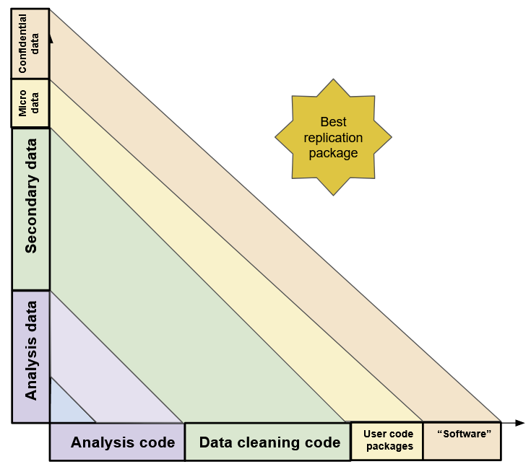
Data
One solution (challenge):
Better transparency!
Data provider
Secondary data
Analysis data
Analysis code
Data cleaning code
User code packages
“Software”
Software

Slide 24
Perspectives from the academic publication process
Opportunities
Challenges
Boring stuff

Slide 25
Perspectives from the academic publication process
Opportunities
Challenges
Boring stuff
New insights
Making data more broadly known
Making data more broadly available
Describing data access and characteristics
Evidence of Generalizability
Repeatability
Persistence
Data citations
Providing code
Documenting what you know

Slide 26


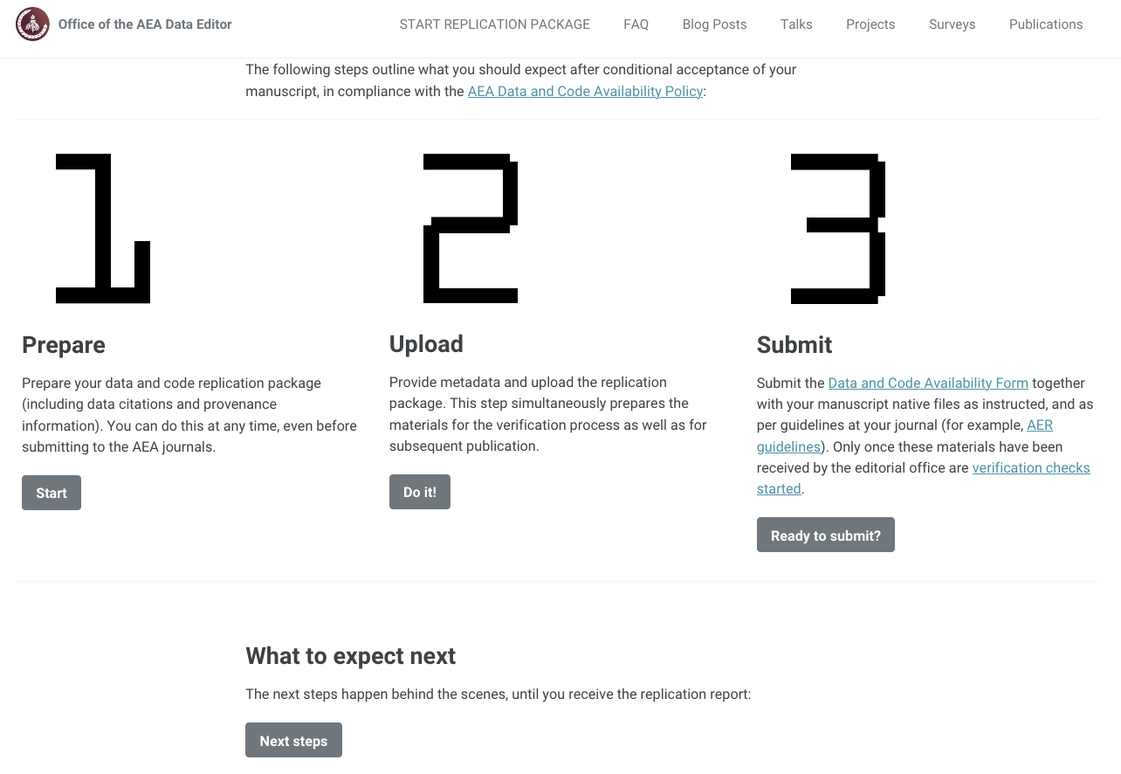
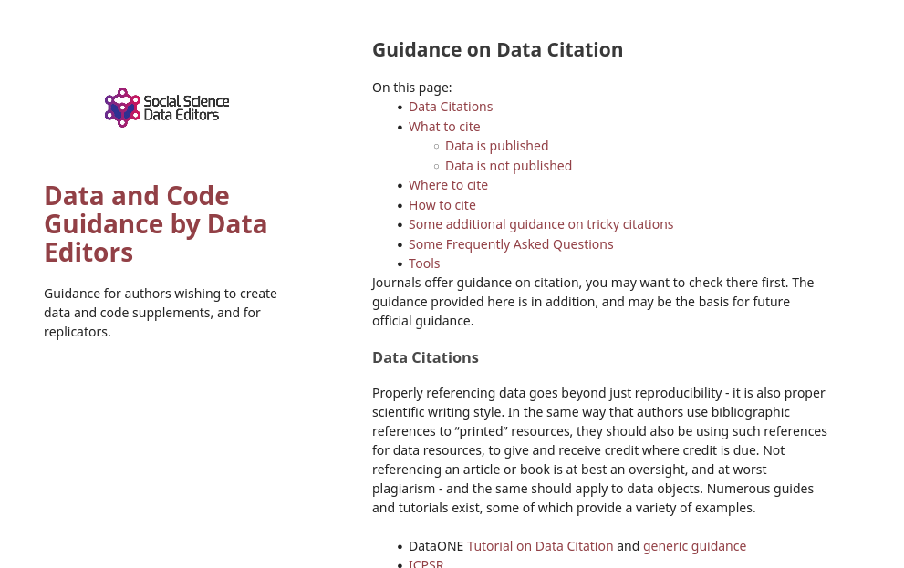
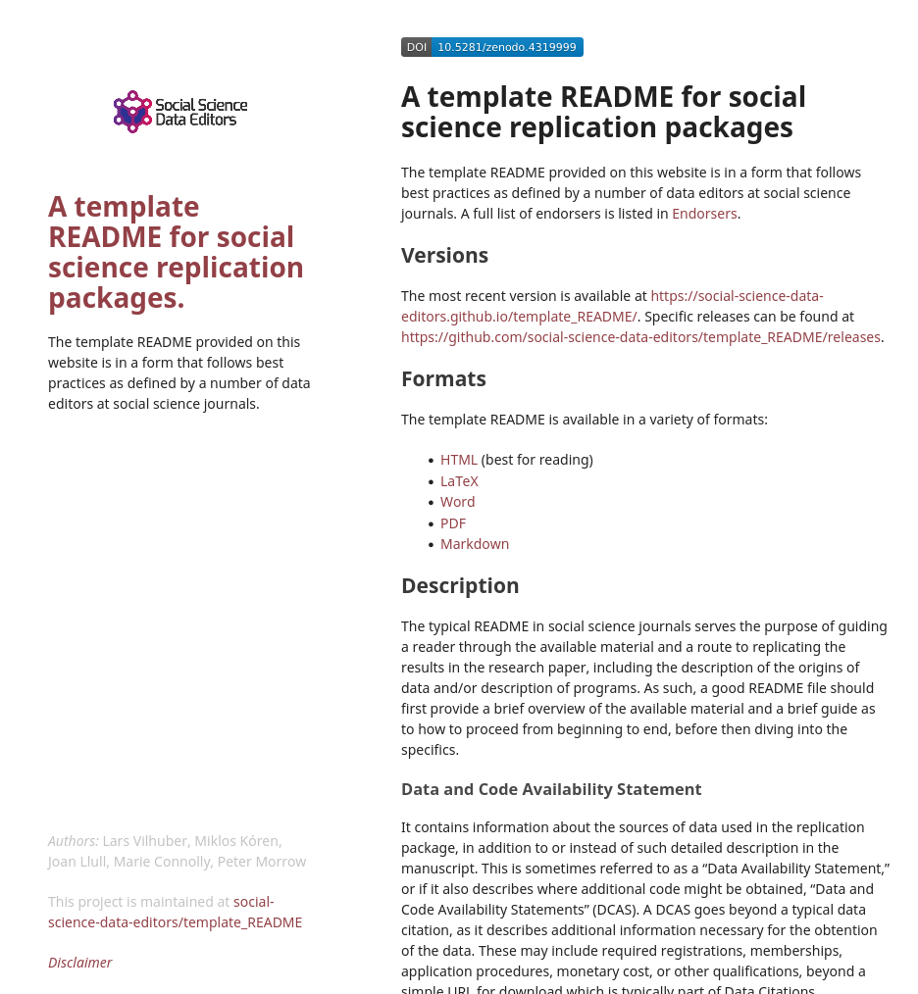

Some solutions from the academic publication process
Opportunities
Challenges
Boring stuff
https://social-science-data-editors.github.io/template_README/
https://social-science-data-editors.github.io/guidance/Data_citation_guidance.html
https://admindatahandbook.mit.edu/
https://aeadataeditor.github.io/aea-de-guidance/

